Slide 1
Logistix
An agregator app for dispatch riders to connect with SMEs

Slide 2
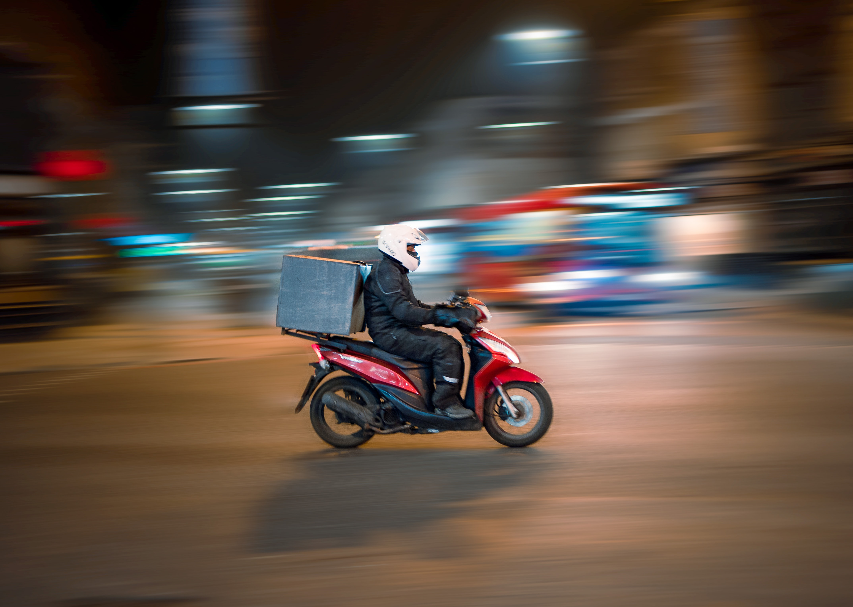
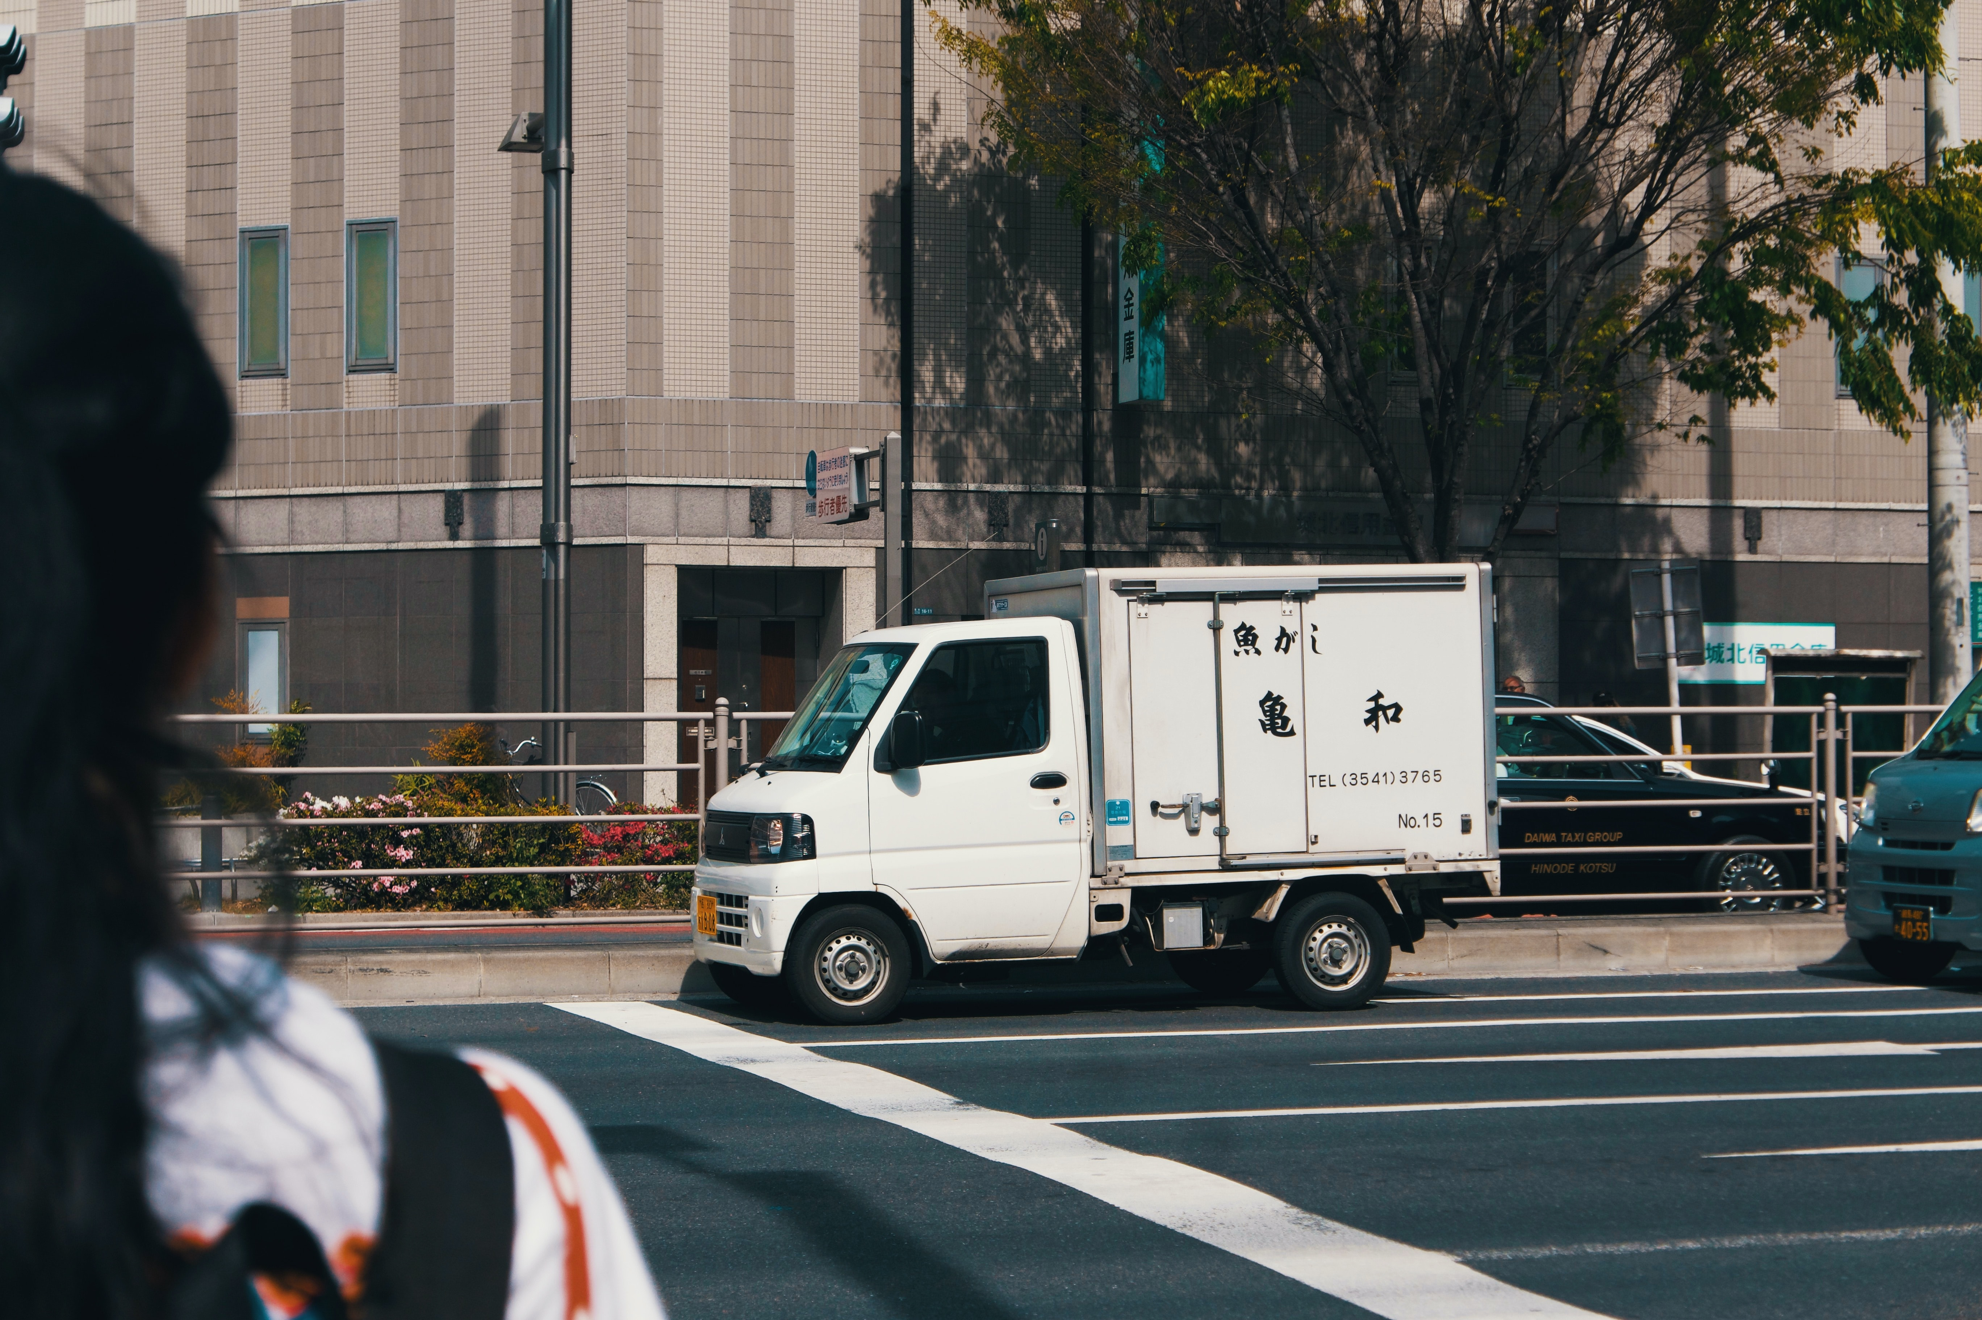
EXECUTIVE SUMMARY .
The purpose of the app is to support Small and medium businesses to find dispatchers, create jobs for the riders/drivers and to ease the delivery process for consumers. Delay in delivery coupled with inability to track goods and the riders have shown negative consequences on the growth and establishment of many SMEs. Finding a way of resolving these problems will enhance growth and expansion for SMEs by giving them credible beneficial gains on how to sustain and gain the loyalty of their target customers. From the research, we have evidence that this is a hole to be filled in the logistics sector and the best news is that there is a ready market for it.

Slide 3
PROBLEM DEFINITION AND OBJECTIVES
TRACKING IMPORTANCE.
SPEED OF DISPATCH TIME
TRUST-WORTHINESS OF DRIVER
01
Consumer’s find it important to have the means of tracking their goods.
02
There has been a problem on the duration between goods dispatch and the minute it is received by the consumer.
There had been complaints of riders in Nigeria who consumed goods or rather people who questioned the quality of goods delivered to them.
03

Slide 4
TARGET USERS
Size
Provide jobs and a stabilized income since they are paid as per the rates of the company.
Helping small/medium business owners protect their brand.
SMBs
Dispatch
Riders/drivers
Consumers
Ensuring buyers have a seamless delivery processs with constant communication.

Slide 5
METHODOLOGY
DATA SCIENCE
DESIGN

Slide 6
DATA COLLECTION.
We curated a questionnaire to target the problem statements.
Our main focus was Nigeria because we heard the problem from a citizen of the country.
Our target number was 70 people but we only got 52 responses. 34 respondents were just consumers while 18 answered as both consumers and entrepreneurs.
COLLECTING
DATA SCIENCE

Slide 7
DATA PROCESS AND PROBLEMS ENCOUNTERED.
Our dataset was stored in a tabular form in google sheets.
The data science team agreed to use python and its libraries to clean the data. Pandas, Numpy, matplotlib.
Most of our questions were compulsory therefore we had 0 duplicates.
PROBLEMS FACED
Few responses.
Late start of project therefore not enough time cleaning.
Personal issues among the data scientists.
DATA SCIENCE
IMPEMENTATION &
FEW CONS.

Slide 8
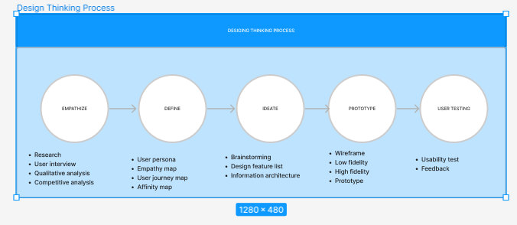
SYSTEM DESIGN.

Slide 9
INFORMATION GATHERED
*we asked the respondents to rate how important fast delivery was to them.
*We found more than 80% respondents felt very strongly as to the importance of fast delivery.
*As per the data, 52 people found it important to track their goods while only 2 were a maybe.

Slide 10
INFORMATION GATHERED
The question that comes next is:
“Do we have a market for our product?”

Slide 11
INFORMATION GATHERED
9 of 10
Consumers are willing to pay for the app

Slide 12
INFORMATION GATHERED
*The higher percentage were willing to pay for the app.
* We believe the ‘maybes’ and some of the no are ‘yeses’ waiting to see our usefulness to them.
6 of 10
Entrepreneurs are willing to pay for the app

Slide 13
IMPLEMENTATION
Integrated Development Environment (IDE) used - Android Studio Electric eel;
Framework :- Flutter
Language :-Dart
Device Preview device:
Backend-Firebase
:- * Firebase authentication:
For authenticating users on the app. Using various methods.
This project used authentication by email and password,
Authentication by providers such as Facebook, and google , but the latter providers were not implemented in the source code . The user can create a user account on the app and login with. Correct details only, else the app won’t be accessible, privacy policy was also added to the project but not yet implemented in the app.
Google cloud map is used and implemented with api .
These api gave access to various functions on the backend that made the map accessible for viewing in the app.

Slide 14
IMPLEMENTATION
Such as google markets but the tracking function is not yet as functional, due to some http bugs experienced from the backend while implementing the app. So the Tracking feature is still a work in progress.
Framework architecture:- None was used when writing the code, but the project has support for flutter bloc and would be used in the project in future.
App specification:
*Client mode as a sender or receiver - features that helps see where your driver or order is, and get to see the profile of the driver with credible information about him/her
* Driver mode as a personal driver , logistics company, or other logistics app integrated into the system - these features have not been implemented yet
Testing and debugging:
The app was built for iOS, android, web, linux, and macOS .

Slide 15
IMPLEMENTATION
Due to constraints in physical devices for debugging not available, and PC not able to carry a virtual device, I used and implemented the app on a DevicePreview hoisted on web(Edge). So all features were modified in accordance to the kind of device I used for debugging, which is device preview. As the source code is written presently it takes minor changes for every feature to work on a physical device. Such as changing all image resources in code to parent data (/assets/image) as this had no support for it on the web, i had to use (image) for it to work in device preview. But it can be viewed presently on a virtual device on the web.
Storage: firebase firestore is used for this project for storing user data for accessibility but hasn't been completely written and used.

Slide 16
RESULTS AND EVALUATION.
Unfortunately, we never got to the user testing of the app. We however believe that the app would bring value to the targeted groups.

Slide 17
CONCLUSIONS.
As the project progressed, we realized that receiving damaged products was not a problem Nigeria faced.
We encourage gathering more data so that it is easier to pin point which Nigerian state would be the best place to deploy the app first.
Due to the constraints of time, the geographical code was not added but it is part of the project and would be added in the fully usable app.

Slide 18
REFERENCES AND APPENDICES
*The source of our information has been primary sources. We curated a questionnaire to answer the questions we had.
Google Collab link.
https://colab.research.google.com/drive/17gBYDdpNJE9-W4WPOM13DWTNjZ1wnXq6?usp=sharing#scrollTo=cpzsxRdBKZer
Questionnaire
https://docs.google.com/forms/d/1r9bo3bfng25wbqUUWRcR4BX9pxPTlzVVfTfvhsxNLD0/edit
Prototype link
https://www.figma.com/proto/df93nZLJGeQKiCLOYx3ZAO/LOGISTIX?page-id=10%3A132&node-id=10%3A132&viewport=803%2C441%2C1&scaling=scale-down&starting-point-node-id=16%3A35
Source code: Github
Screenshots: images and video
https://docs.google.com/document/d/1jBKFk9MJI3mnD2tg7mk9Gyws7FeI1mAUJX1GvBDH4XY/edit#

Slide 19
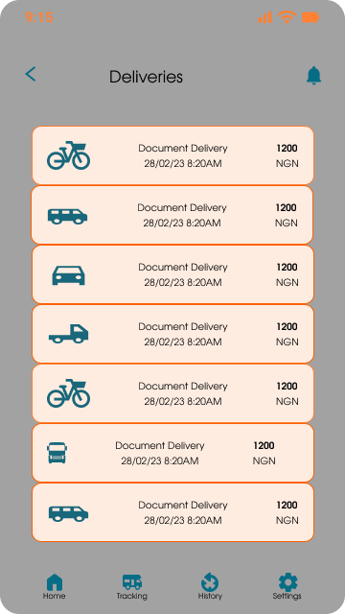
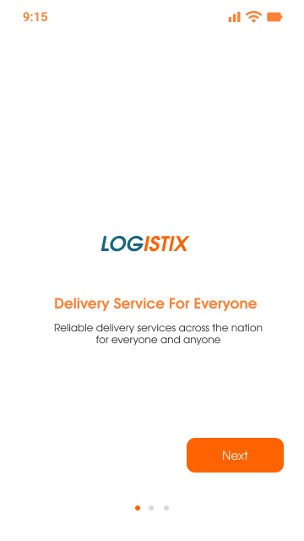
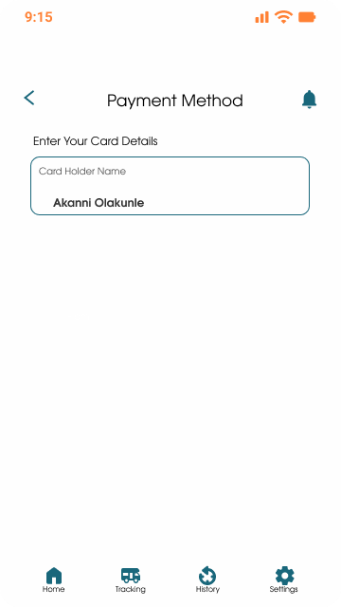
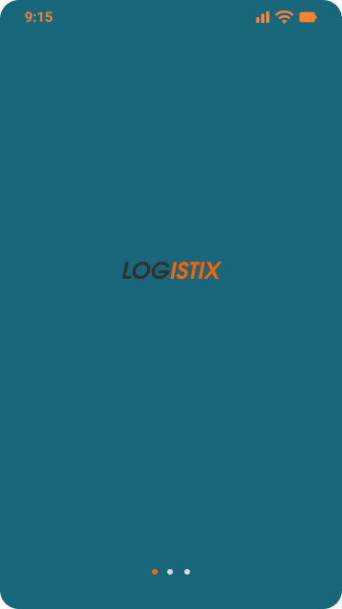
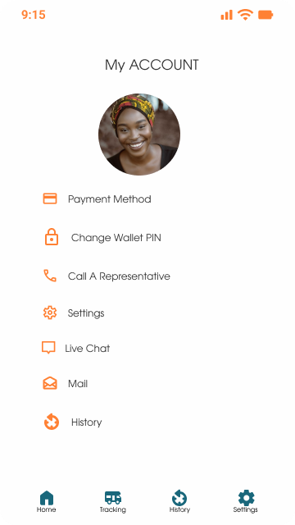
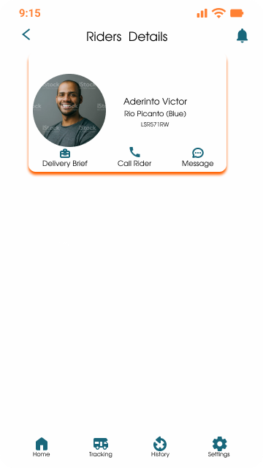
s
REFERENCES AND APPENDICES

Slide 20
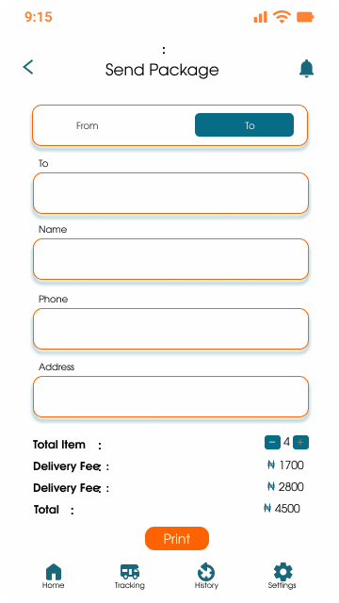
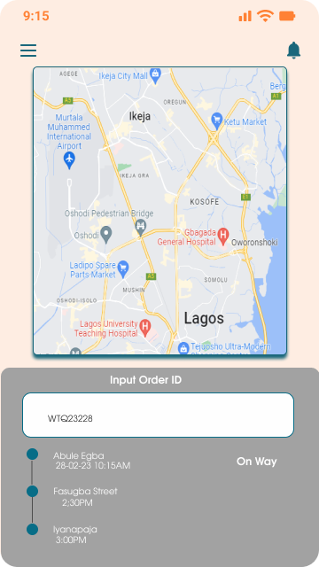
s
REFERENCES AND APPENDICES

Slide 21
s
REFERENCES AND APPENDICES
Apk: apk

Slide 22
TECHNICAL REPORT.
The user opens the app and a splash screen with the logo shows followed by an onboarding screen that highlights some features of the app , the user then creates an account, the login screen will then be brought up and the user logs in their correct details else they won’t be granted access.
When access is granted, the home screen shows different features the user can use, such as tracking packages, booking advance delivery, selecting default location, sending a package, which the user is then required to fill in various information about the package, and selecting destination and user location.
Then having the option to choose their driver and means of transportation from the available drivers in their proximity. An option to pay with cash on delivery, credit or debit card.

Slide 23
TECHNICAL REPORT.
Packages used:
cupertino_icons: ^1.0.2
introduction_screen: ^3.1.6
device_preview: ^1.1.0
dots_indicator: ^2.1.0
firebase_core: ^2.7.0
firebase_auth: ^4.2.9
flutter_bloc: ^8.1.2
equatable: ^2.0.5
location: ^4.4.0
google_maps_flutter_web: ^0.4.0+6
flutter_spinkit: ^5.1.0
cloud_firestore: ^4.4.3
google_sign_in: ^6.0.1
sizer: ^2.0.15
persistent_bottom_nav_bar: ^5.0.2
flutter_polyline_points: ^1.0.0
google_maps_flutter: ^2.2.5
flutter_svg: ^2.0.2
dev_dependencies:
flutter_test:
sdk: flutter
Font used :
-Evolventa
-Poppins
External dependencies:
*FLutter CLI,
*Flutter sdk,
*Dart sdk,
*Firebase_options,
*Google maps API
*Flutter plugins
*Dart plugins
*IntelliJ idea
*Java JDK
*Minsdk in android =20.

